Slide 1
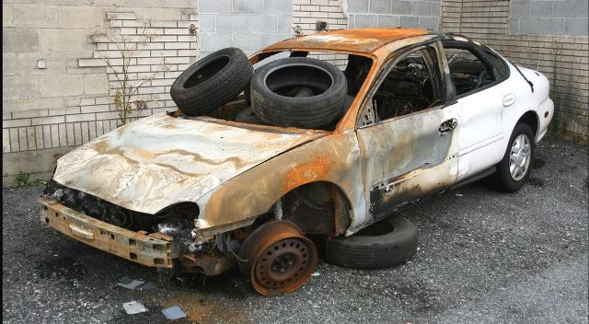
Don’t Get Kicked
Tyler Smith

Slide 2
Problem Background
”Kicked cars” refer to cars purchased by auto dealerships at auto auctions that turn out to be bad purchases for various reasons.
Searching for a new car is stressful enough; customers shouldn’t be worried about getting scammed into buying a piece of junk!
Lucky for us, machine learning is making it easier for auto dealerships to keep their inventory up to their customers’ standards by identifying kicked cars.

Slide 3
Feature Engineering
Response variable = IsBadBuy (0 or 1)
My recipe has many steps that cater to specific complexities of the Don't Get Kicked data:
step_novel and step_unknown are used to address novel factor levels in nominal predictors that might appear in new data but are not present in the training set. We then assign any unknown factor levels to their own group using step_unknown.
step_lencode_mixed is where we add target encoding to the mix. Target encoding is when we convert a categorical variable to the mean of our response variable, which is IsBadBuy in our case.
step_impute_mean helps us address missing values even further. This is going to assign the mean of respective columns if missing values are present.
step_corr addresses the potential issue of multicollinearity. If features are highly correlated with each other, this step will remove one of them.
step_zv removes any variables in the dataset that have zero variance.
step_normalize normalizes numerical predictors. The normalized data will have a mean of 0 and standard deviation of 1.

Slide 4
Model Comparison
BART = .237
Penalized Logistic Regression = .234
Boosting = .223
Naive Bayes = .222
KNN = .178

Slide 5

Bayesian Additive Regression Models (BART)
Large number of regression trees are fitted to the data and each tree explains a small portion of the response variable.
Bayesian: Use probabilities to express uncertainty in model parameters.
Additive: Each tree of the BART model will explain a small portion of the overall prediction. We then combine what we find out from each tree to make our final prediction.
Regression Trees: Data is split into subsets. Each leaf node makes a class prediction based off the class majority since the outcome is binary.

Slide 6
Final Score
BART gave me the highest score out of all the models.
Final score = .237

